Slide 1
Online Central Records System
The Records Section Guide

Slide 2
The Records Officer Functions
Apart from the Document circulation shown in the Online Records System manual, the Records Officer are also tasked with other functions:
1. User Management – this tab not only deals with modifying Usernames/passwords, but also of the Divisions’ security phrase (allowing the creation of new users), as well as the Officer List (for the selection of Officers apart from the Office in the Routing)

Slide 3
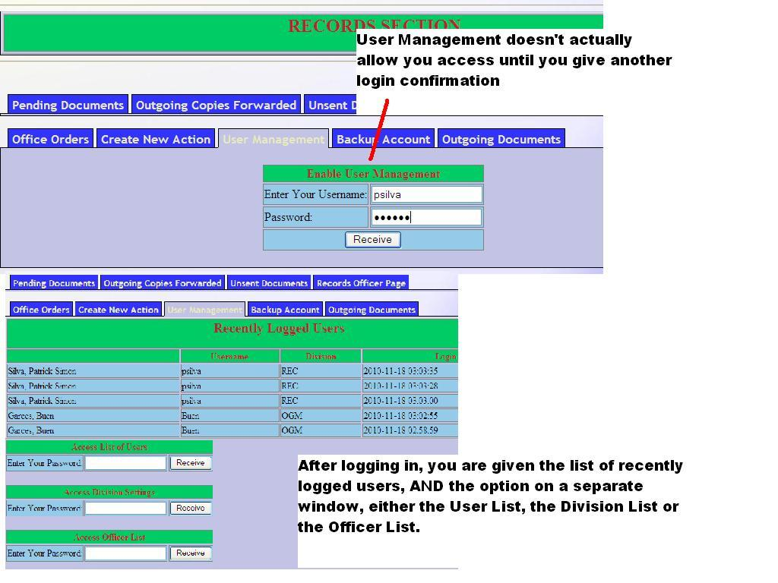

Slide 4
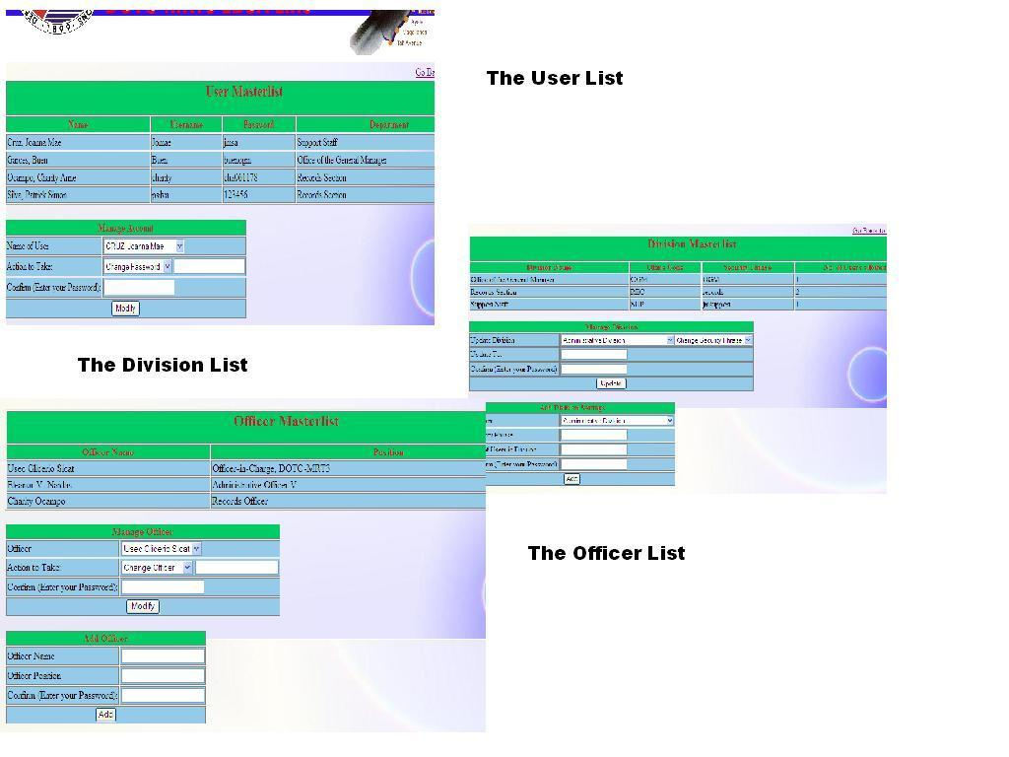

Slide 5
The Records Officer Functions
2. The Outgoing Documents tab shows all Documents approved by the GM; if we study the physical process of the Document Life Cycle (see next page) we can see that this is where the Document (if it is not already printed out), is printed and then sent out. Here, the Records Officer has the option of forwarding a copy internally to any office

Slide 6
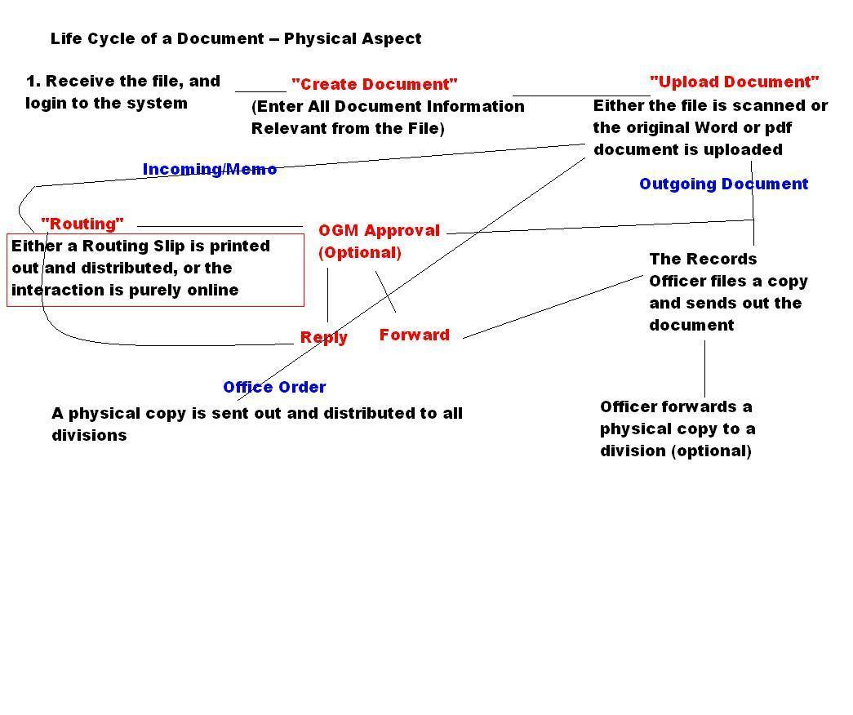

Slide 7
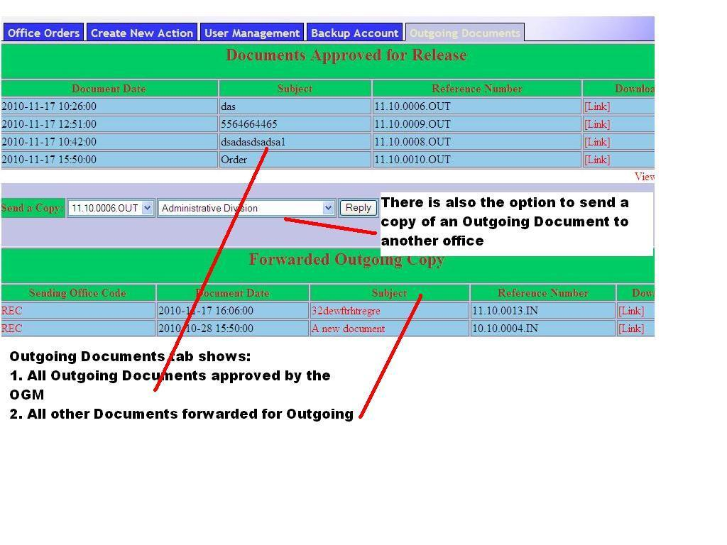

Slide 8
The Records Officer Functions
3. The Records Officer Page works like a monitoring, showing all active documents and its “flow” (from which department, what actions were made, etc.)
However, to get a complete list of all documents generated within the month, and the ones active at that date, an End of the Month Report tab exists

Slide 9
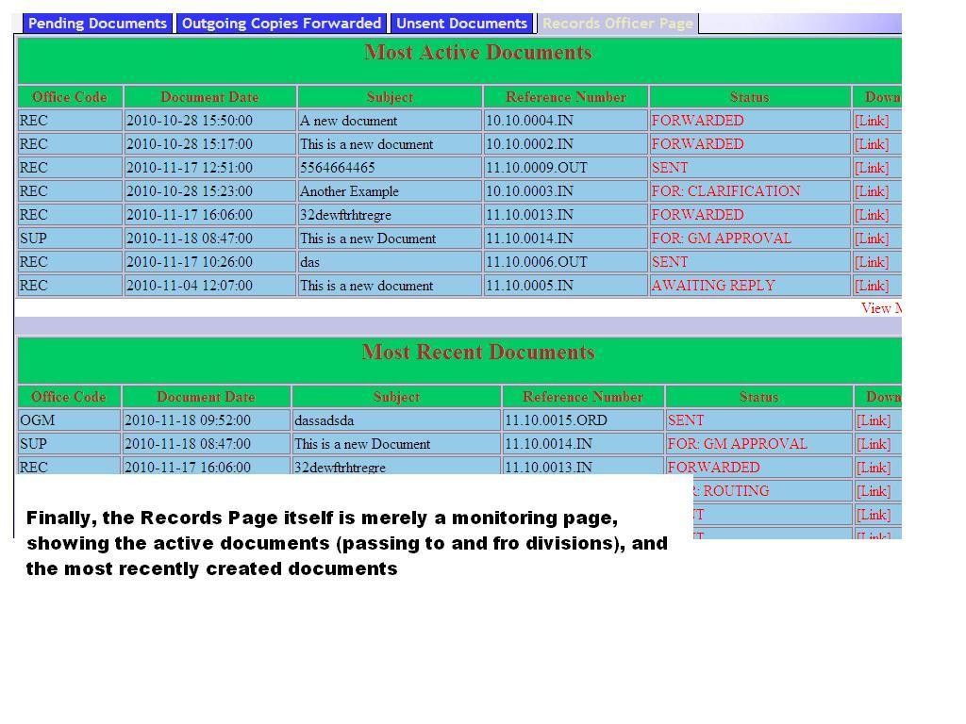

Slide 10
The Records Officer Functions
3. The End of the Month Report has three essential parts: Office Orders, All Sent documents (whether going in or out of the office), and All Unsent (whether not routed or not uploaded);
All of these are documents occurring within the month

Slide 11
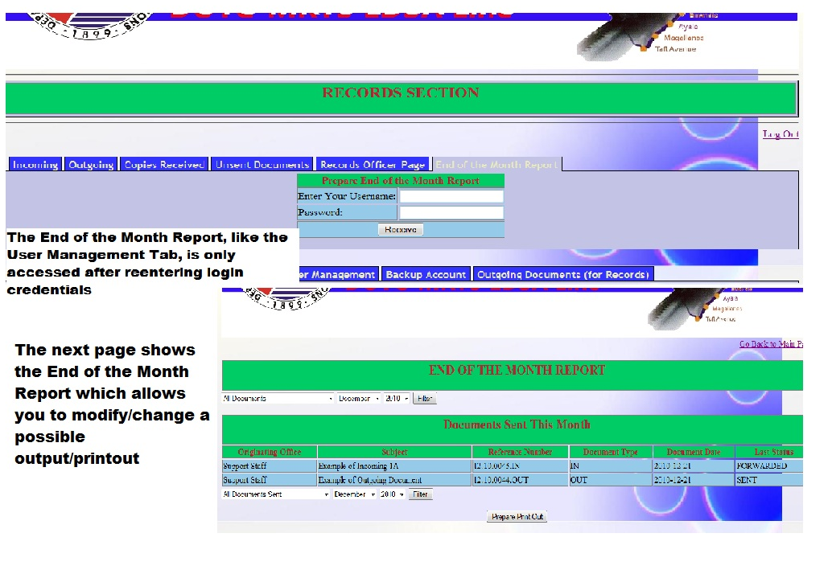

Slide 12
The Records Officer Functions
3. The End of the Month Report can be modified to “filter” or specify what it displays (e.g. only All Orders and Sent Orders for November, etc.). The changes that are saved there will directly change what the Excel Printout (similar to Routing Printout) will be.

Slide 13
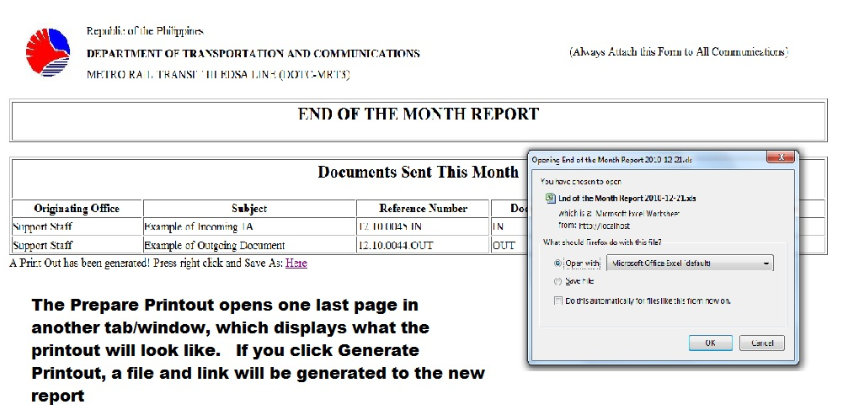

Slide 14
The Records Officer Functions
3. Like the Routing Slip, you prepare the printout by clicking on “Prepare Printout”. A new page pops up, showing the printout format. When you are ready to create the Excel file, simply click the Generate Printout, and the link will be provided to you

Slide 15
The Records Officer Functions
4. The Backup Account is the last, and simplest function to use. In the tab, if you click on the checkbox, and press Confirm, the Backup Account will Enable/Disable, depending on whether it was disabled or enabled in the first place

Slide 16
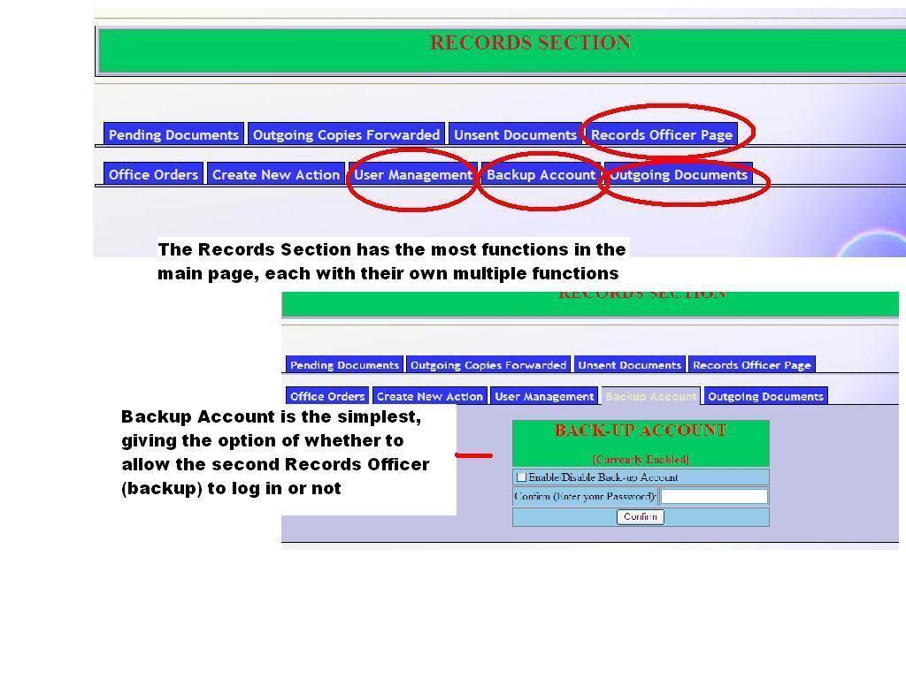

Slide 17
The Records Officer Functions
For additional information on the Records Officer or for other inquiries, see the main manual

